Slide 1
THE INTERNATIONAL GARDEN - the travelling seed -

Slide 2
About us During the school year different schools from different European countries may decide to take part in the project. Every participant sends each other some seeds of a plant/flower which represent/ are traditional/ can be found in their country. Every seed need a ‘’Plant passport’’, written in English and in the original country language. All partners plants the seeds and searches for information about the countries the seed came from. The project finishes when the seeds turn in plant: the children can write ''The journal of a travelling seed'', with all the facts they have learnt during this project, and draw a picture of their International Garden . Outcomes Each school do researches on the countries the seeds come from (where the countries are on the map, capital city, population, climate, traditions, currencies- adapted to the pupils’ age and abilities). In addition, the school creates a display with the map of Europe and the journey of the seeds. Teachers search on the languages of the participant schools (similarities, differences, etc), to translate the passport as accurately as possible, and to learn a few words in that language (hello, good-bye, colours, etc). The pupils will know more about the world around us. They will be introduced to the different languages and they will learn a few words in some languages, they do not normally learn at school. Finally, children will know more about other’s culture and traditions.

Slide 3
Working togheter
Each school plants their seeds, following the instruction they received (what kind of climate the plant needs, how much water, light, shade, indoor, outdoor, etc).
School ambassadors walk around the school once a week to take notes: if the plants are growing/ if they look fine/ if they need to be moved outside or inside etc.
The schools- all the participants- take pictures and short videos with the whole growing process of the plant from the seed to the adult plant. At the end of the project, everyone makes a PPT/ video with all the steps they have followed, with one final slide/ picture presenting all the plants with their passport and the countries’ flags, ‘’smiling’’ in our International Garden.
The project starts in February and ends in June
Results:
Video
Twinspace
PPT, pictures, blogs.

Slide 4
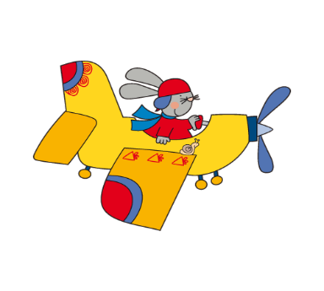
HELLO PUPILS I’M YOUR RABBIT FRIEND GIULIO
HELLO FROM ENGLAND
RABBIT GIULIO HAS A BEAUTIFUL SURPRISE FOR YOU: HE HAS BROUGHT ME SOME BULBS AND I WLL GIVE HIM MANY SEEDS OF WONDERFUL COLORED FLOWERS.

Slide 5
DISCOVERING EUROPE: WHERE IS GIULIO ? WHERE ARE WE?

Slide 6
WONDERFUL LITTLE PACKAGES

Slide 7
THE ENVELOPES ARE READY: THEY WILL START A GREAT JOURNEY, LIKE «TINY SEED»….CARRIED BY THE WIND

Slide 8
….OUR EUROPEAN FRIENDS ARE READY…

Slide 9
THE LOGOS

Slide 10
THE FIRST LETTER!

Slide 11
LET’S OBSERVE THE LETTERS: THEY HAVE DIFFERENT WRITINGS, STAMPS AND DRAWINGS! AND NOW LET’S ENTITLE THE AMBASSADORS WHO WILL TAKE CURE OF THE SEEDS

Slide 12
BONJOUR IN ALL LANGUAGES

Slide 13
OUR SEEDBED

Slide 14
LET’S INVOLVE OUR PARENTS: they translate some letters……

Slide 15
OUR DISPLAY IS EVOLVING…

Slide 16
LET’S MAKE EUROPE WITH OUR BODY

Slide 17
L’EUROPA CORPOREA : I BAMBINI SI DISPONGONO SUL PAVIMENTO RICOPERTI CON STOFFE PER RAPPRESENTARE LE BANDIERE DEGLI STATI EUROPEI
INSEGNANTE: PARTIAMO DALL’ITALIA..... IN QUALE PARTE DELLA CARTINA E’ L’ITALIA?
BAMBINI: AL CENTRO…DOVE C’E’ IL MARE….. COMPONGONO L’ITALIA E LA SUA BANDIERA ALCUNI BAMBINI DI TRE ANNI.
INSEGNANTE : LA FRANCIA CHE FORMA HA? RICCARDO: UN QUADRATO…..
QUATTRO BAMBINI SI DISPONGONO PER FORMARE LA FRANCIA E VENGONO RICOPERTI DA ALCUNI COMPAGNI
EMANUELE: LA SPAGNA SEMBRA UNA PISTOLA FRANCESCO: UNA MACCHINA
RICCARDO: LA FACCIA DI UN DELFINO
FRANCESCO: LA SPAGNA HA LE RIGHE AL CONTRARIO DELL’ITALIA
EMANUELE: HA UN PEZZETTINO ATTACCATO ALLA FRANCIA
SI POSIZIONANO PER LA FORMAZIONE DELLA SPAGNA
GAIA M. : L’INGHILTERRA HA LA FORMA DI UNA BEFANINA
YOUSRA: UNA DONNINA ASIA: CON UN VESTITO LUNGO
PATRICK: E UN CAPPELLO SULLA TESTA
GAIA M. : LA BANDIERA E’BLU CON LE CORDE ROSSE
BIANCA: LA GERMANIA SEMBRA UNA PIZZA EMANUELE: I COCCODRILLI
YOUSRA: IL DRAGO GAIA G.: L’ORCO CON LA CORONA
ARIJ SI PIEGA PER FARE LA BOCCA DEL DRAGO
PATRICK: LA POLONIA SEMBRA UN TRENO
EMANUELE: UN CAMION AMIN: UNA MUCCA LEONARDO: UN RAGNO
GAIA: DOBBIAMO METTERCI COSI’… (INDICA CON LE MANI LA POSIZIONE DELLE STRISCE DELLA BANDIERA)
AMIN: MANCA LA LETTONIA…E’ PICCOLA COME LA DALIA
LA SLOVENIA E’ PICCOLA METTIAMO LEONARDO
EMANUELE: LA ROMANIA MI SEMBRA UN ORSO
FRANCESCO: LA BULGARIA HA TRE COLORI NELLA BANDIERA
TUTTI: LA GRECIA HA LA FORMA DI UNA MANO
BIANCA: IL PORTOGALLO E’ UNA STRISCIA PICCOLINA
GLEDIA SI SDRAIA PER FORMARE IL POROGALLO

Slide 18
EVERY COUNTRY LOOKS LIKE…. …FROM FANTASY TO GEOMETRY

Slide 19
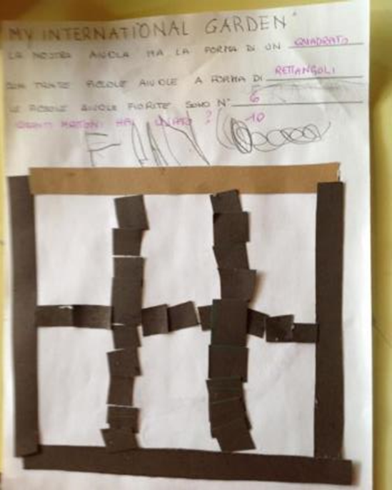
A BIG FLOWERBED:THANKS MUNICIPAL ADMINISTRATION

Slide 20
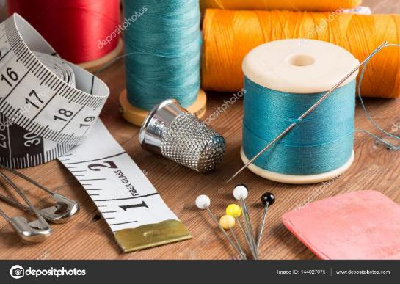
MEANTIME…
…. WHILE MOTHERS AND GRANDMOTHERS SEW THE FLAGS!

Slide 21
SPANISH STUDENTS MAKE ESPERIMENTS AND WE OBSERVE THEM

Slide 22
IT’S EASTER: LET’S DRAW A BIG EGG WITH EVERY DIFFERENT GOOD WISH, FLAGS AND SEEDS FROM ALL THE PARTICIPANT COUNTRIES

Slide 23
WE GOT EXCITED listening THIS VIDEO called «Flowers» …… AND TOGHETER WE TALKED ABOUT IT

Slide 24
OBSERVING THE PICTURES OF OUR EUROPEAN FRIENDS, WE DRAW THE POSITIONS OF THE BODY: ARMS UP!

Slide 25
…ONE ARM UP AND ONE DOWN

Slide 26
…DOWN ON KNEES

Slide 27
EVERY AMBASSADOR TRANSPLANTS HIS BUD: IT GROWS WITH SATISFACTION!

Slide 28
LEARNING BY READING BOOKS, WE COMPLETE OPERATIONAL SHEETS

Slide 29
CODING… NATURE

Slide 30
PORTUGUESE FRIENDS HAVE SENT A WONDERFUL VIDEO: HOW EXCITING!

Slide 31
FRENCH CHILDREN SHOW FRANCE

Slide 32
….THINKING ABOUT US: WHAT DO I KNOW?WHERE DO I LIVE? Introduce ourselves to European friends

Slide 33
SOMEONE HAS VISITED MILAN BUT NOONE HAVE SEEN LEONARDO DA VINCI’S MASTERPIECE

Slide 34
SOMEONE HAS GONE TO THE MOUNTAINS AND SOMEONE TO THE LAKE

Slide 35
MEANTIME……FLOWERS PARTY: WE SING, WE GET DIRTY… WE HAVE FUN!…IN ART YOU ARE NEVER WRONG!

Slide 36
SOME QUESTIONS FROM FRANCE…. WE START OUR RESEARCH about italian gardens…..

Slide 37
….ITALIAN GARDENS BETWEEN GEOMETRY, STATUES AND FOUNTAINS

Slide 38
.
THIS STORY IS SET IN GARDEN OF BOBOLI, IN FLORENCE. NICCOLO’ TRIBOLO WAS ITS ITALIAN GARDENER

Slide 39
A BEAUTIFUL STORY...BIG EMOTIONS

Slide 40
GARDEN VOCABOLARY: LISTEN AND RECORD

Slide 41
THE ENGLISH STUDENTS SEND A INVITATION

Slide 42
WE REALIZE OUR RED BOOK FOR HUMPHRY REMPTON’S DEATH BICENTENARY

Slide 43
IMPROVING THE LANDSCAPE WITH OUR ART…WE IMITATE REMPTON!

Slide 44
WE WATCH «FERDINAND» AT THE CINEMA: A BULL IN LOVE WITH FLOWERS

Slide 45
AS FERDINAND GOES TO THE FLOWERS FEAST…AS FESTAS DO POVO CAMPO MAJOR IN PORTUGAL AND OUR FEAST SAINT TITO IN CASORATE SEMPIONE…

Slide 46
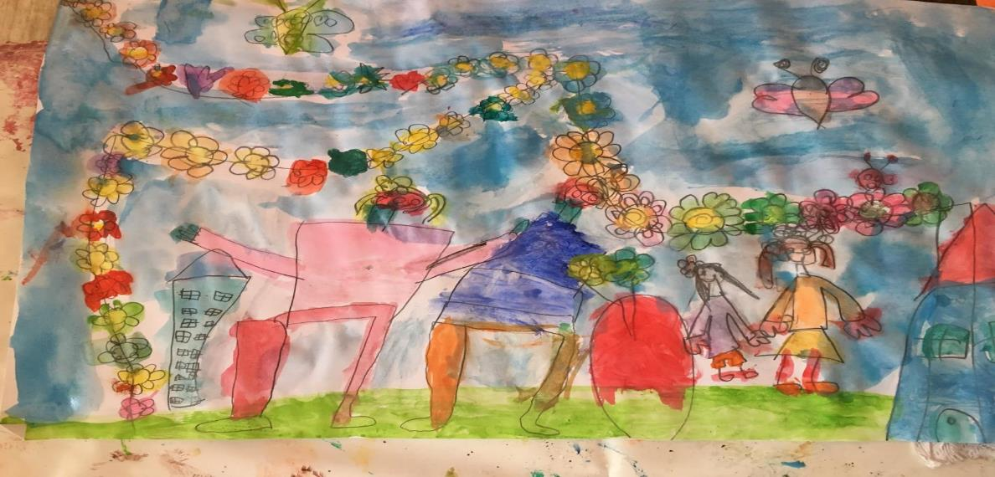
OUR INTERNATIONAL GARDEN TAKES US AWAY

Slide 47
OUR DIARY HAS BEEN WITH US SINCE THE EARLY DAYS

Slide 48
DISSEMINATION: LET’S SHOW OUR WORKS!

Slide 49
IN THE END…
OUR PUPILS ALWAYS SAY TO US…….
…WILL WE GO TO LONDON?????

Slide 50
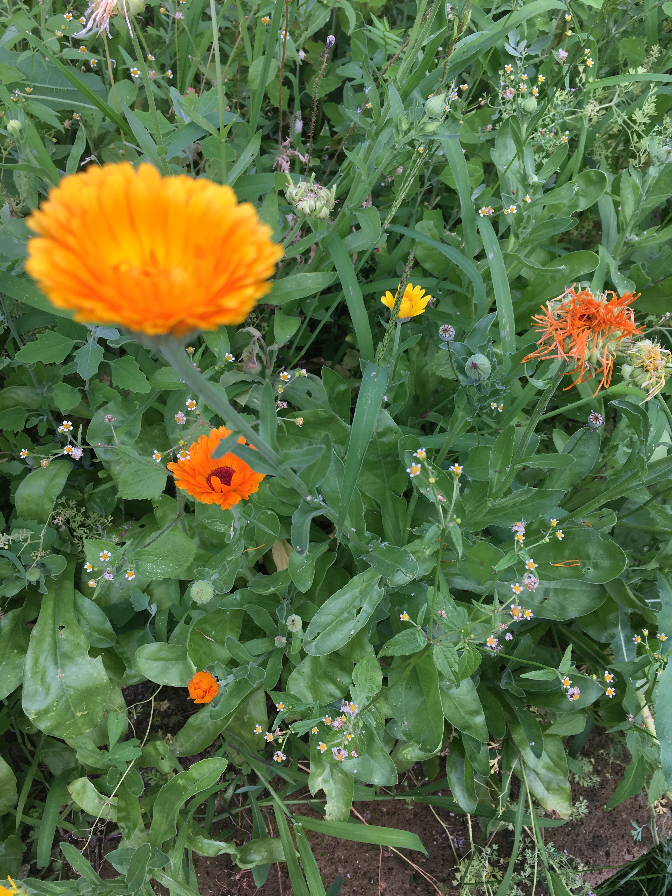
GREETINGS FROM ITALY….with our international garden

